Slide 1
Independent Reading
How do strong readers choose a book? What kind of selection strategies do they engage in?
Recommendations, online reviews, author (past reading/bio), genre, cover, awards, summary on back, seen the movie, read the 1st page, challenging, summer reading table, book reviews.
How will you choose???

Slide 2
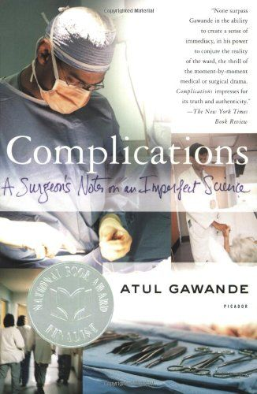
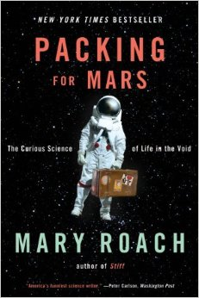
Nonfiction

Slide 3
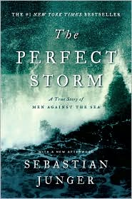
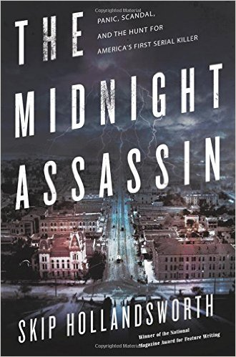
Nonfiction
Notes:
Add rejects from AP? What about Enrique’s Journey?

Slide 4
Nonfiction

Slide 5
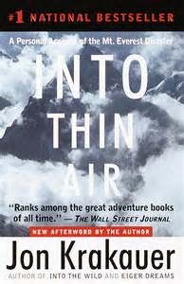
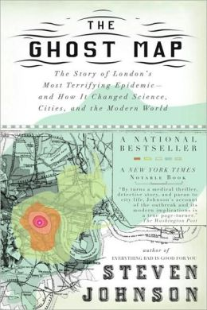
Nonfiction

Slide 6
Nonfiction
Note: If you pick this one, you must buy THIS version—Outcasts Unite: An American Town, a Refugee Team, and One Woman’s Quest to Make a Difference
DO NOT order Outcasts United: The Story of a Refugee Soccer Team That Changed a Town—that’s the young reader’s version.

Slide 7
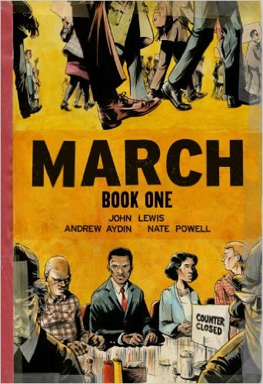
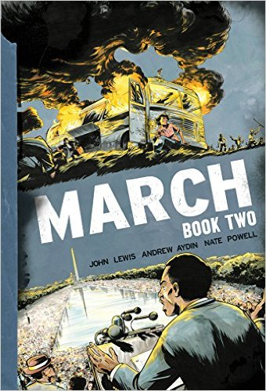
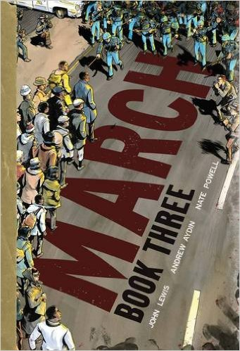
Nonfiction
If you select the John Lewis March trilogy of graphic novels, you need to read ALL THREE. Do know that it will cost you about $36 to buy them all.

